Slide 1
reversing reverse engineering
with avantika

Slide 2
~# who is our detective
avantika (@iamavu)
a girl who dabbles in security
makes music sometimes
loves memes :D
breaks things
Notes:
who am i
OSINT joke
my view on how i see to learn reversing

Slide 3

wandering between these 1s and 0s
Notes:
you go an about in tech world
getting to know things
how it works

Slide 4

hmm, weird strange binary?!
Notes:
what are binaries

Slide 5
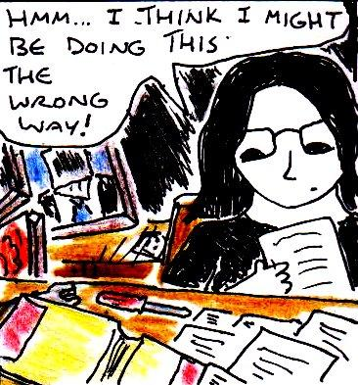
it’s reversing time
Notes:
what is reversing
what is forward engineering i.e programing
to break something you must know how it is built

Slide 6

think simple
Notes:
think simple
often we try complex things
missing out on simple approaches

Slide 7
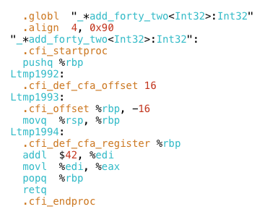
scary, ain’t it?
Notes:
assembly looks scary but it isn’t
learn to read asm, you aren’t going to spend much time writing it

Slide 8

let’s look back into the past, shall we?
Notes:
go back to notes
go to basics
learn by godbolt
compare c code and asm code
write your own code, see it’s decompilation

Slide 9
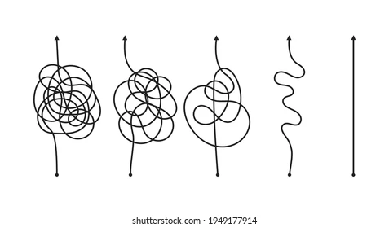
solve and solve
flags and flags
shells and shells
Notes:
focus on what’s important

Slide 10
think simple, always
Notes:
as i said, think simple
ltrace

Slide 11

how do i be better?
Notes:
be curious and hungry for more

